Slide 1
Python Scientific Calculator
Name: Sanjit Kumar Tiwari
Project: Advanced GUI-based calculator using Python and Tkinter
Company: Next hikes IT Solutions

Slide 2
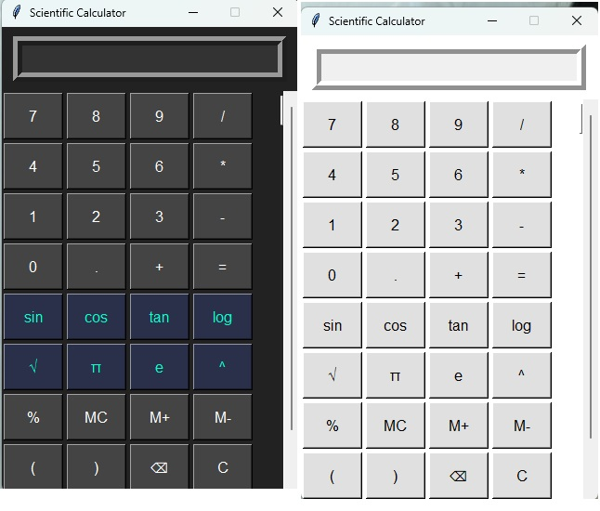
introduction
A feature-rich scientific calculator built with Python.
Designed with a modern user interface using Tkinter.
Includes both basic and advanced scientific functionalities
Memory operations (MC, MR, M+, M−)
Expression evaluation and error handling
Dark/light theme toggle.

Slide 3
Objective
Create a user-friendly calculator with:
Basic arithmetic functions (add, subtract, multiply, divide).
Scientific operations (sin, cos, tan, log, factorial, etc.).
Memory functions (MC, MR, M+, M−).
A modern, intuitive Graphical User Interface (GUI).

Slide 4
Tools & Technologies
Programming Language: Python
GUI Library: Tkinter
Math Functions: Python’s math module
OS Compatibility: Cross-platform (Windows, Linux, macOS)
.

Slide 5
Key Components
Libraries Used: | GUI Design (Tkinter) | Scientific Calculator Operations
Tkinter: GUI design. | Main Window: | Basic Operations: Addition, subtraction, multiplication, and division are supported with simple button clicks.
math: Performing scientific operations. | Root window with a title ("Scientific Calculator") and fixed size. | Scientific Operations:
re: Regular expressions for input validation and manipulation. | Entry Widget: | Buttons for operations like sin, cos, tan, log, square root (√), and exponentiation (^).
tkinter.messagebox: Display pop-up messages for user interaction | Displays the current expression or result. Supports input and updates dynamically. | Input Handling:
Degree and radian conversions | Canvas and Scrollbar: | User can add functions to the calculation input using the corresponding buttons.
Expression evaluation and error handling | To contain all buttons and ensure they are scrollable for better usability.

Slide 6
Key Features
Memory Functions | History Functionality | Input Validation and Restrictions
Memory Store: | History Tracking: | Disallowed Input:
Store, add, subtract, and recall results with memory buttons (MC, M+, M-, MR). | The calculator keeps a history of all operations. | Restricts specific disallowed text like random alphabetic characters unless part of a scientific function.
Memory Calculation: | Recheck Inputs: | Letter Detection:
Adds or subtracts the result of an operation to/from memory. | User can view previous calculations and recheck or correct them. | Letters are blocked unless part of valid scientific operations such as sin, cos, etc
Memory Clear: | Popup Window: | Regex Use:
Clears the stored value in memory. | A Listbox shows the history, and the user can select an input to reload into the calculator. | Regular expressions ensure proper formatting for scientific functions like sin, cos, and tan.

Slide 7
Unique Functionalities
Theming and UI Customization-Light/Dark Themes:Users can toggle between a light and dark theme.
Theme Customization:Buttons, entry widget, and background colors change based on the selected theme.
Button Styling:Scientific buttons styled differently in dark mode to improve readability.
Error Handling:Try-Except Blocks:Used for error handling in calculations, ensuring that invalid inputs do not crash the app.
Invalid Calculations:If an error occurs (e.g., division by zero), a message is displayed in the entry field (e.g., "Error: Invalid operation").
Theming and UI Customization-Light/Dark Themes:Users can toggle between a light and dark theme.

Slide 8
Working Demo
How It Works
Input handling with Entry widget
Button grid layout using Tkinter
press(), equal(), and memory functions
Custom expression parser and math evaluation

Slide 9
conclusion
Fully functional scientific calculator using Python.
Combines ease of use with powerful math capabilities.
A great example of applying GUI development in real-world apps

Slide 10

Thank you

